Slide 1
Diabetes Management

Slide 2
Continuous Glucose Monitoring
Better Management
Optimizing the insulin dosage
Creating Exercise plans
Creating Dietary plans
Optimizing medications
Monitoring abnormalities in real time

Slide 3
What is a CGM? (Continuous Glucose Monitor)
A device that provides “real-time” glucose readings and data about trends in glucose levels
Reads the glucose levels under the skin every 1-5 minutes (10-15 minute delay)
Provides alarms for high and low glucose levels and trend information
The 3rd era in diabetes management

Slide 4
Who Should Use a CGM?
The person and the family(caretakers) might both want a CGM
A youth must be willing to wear the sensor (and carry the receiver)
Using good diabetes care
Good support system
Adequate body “real estate”
Cost of CGM

Slide 5
Continuous Glucose Monitoring (CGM) WHY?
Prevention of low blood sugars (alarms)
Prevention of high blood sugars Minimize wide glucose fluctuations
Behavior Modification
Prevention of Complications

Slide 6
How common are glucose levels <60mg/dl during the night in children with T1D?
French (i) and Australian (ii) data showed approximately 50% of children with low BG (<60mg/dl) during the night (on NPH bid)
DirecNet data (one night in hospital with blood sugars every 30 min.)
A) 2001-2002: 39 of 91 (43%) low BG
(44% of children on insulin pumps/56% on NPH)
B) 2004: 14 of 50 (28%) with low BG
(all on insulin pumps or Lantus)
Beregszaszi M, et al. J Pediatr. 131, 27, 1997
Porter PA, et al. J. Pediatr. 13, 366, 1997

Slide 7
Continuous Glucose Monitoring (CGM) WHY?
Prevention of low blood sugars (alarms)
Prevention of high blood sugars
Minimize wide glucose fluctuations
Behavior Modification
Prevention of Complications

Slide 8
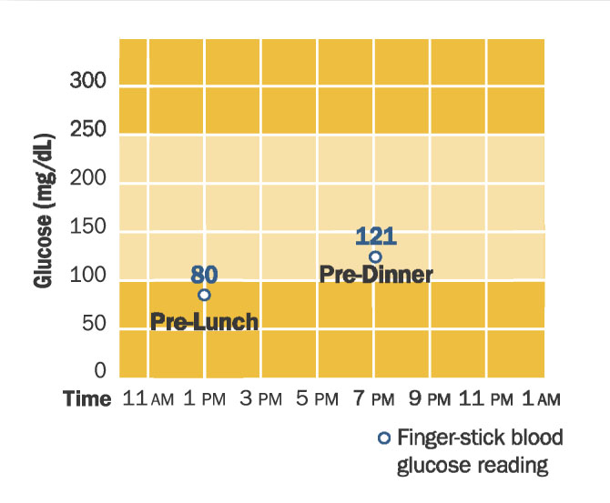
“Snapshot of BG levels”

Slide 9
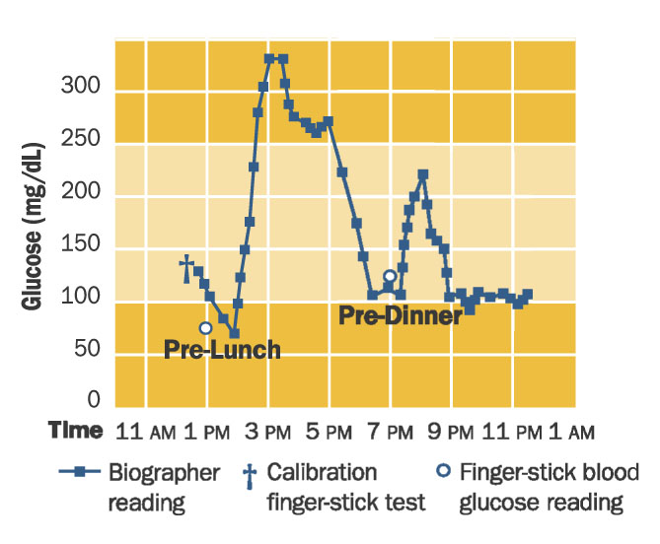
Continuous Glucose Monitoring

Slide 10
Hyperglycemia is common, especially after meals
50%
40%
30%
Breakfast
Lunch
20%
Dinner
10%
0%
< 180
181 - 240
241 - 300
> 300
Boland et al, Diabetes Care 24:1858, 2001

Slide 11
Continuous Glucose Monitoring (CGM) WHY?
Prevention of low blood sugars (alarms)
Prevention of high blood sugars
Minimize wide glucose fluctuations
Behavior Modification
Prevention of Complications

Slide 12
Three Parts to All CGMs:
Sensor
Transmitter
Receiver/Monitor

Slide 13
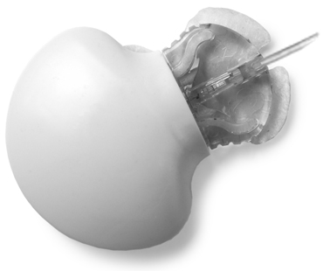
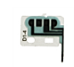
Sensor

Slide 14
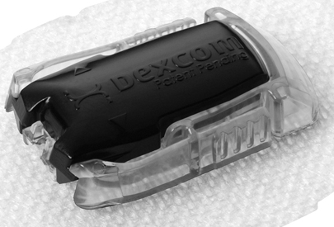
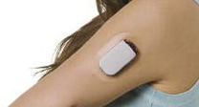
B)Transmitter

Slide 15
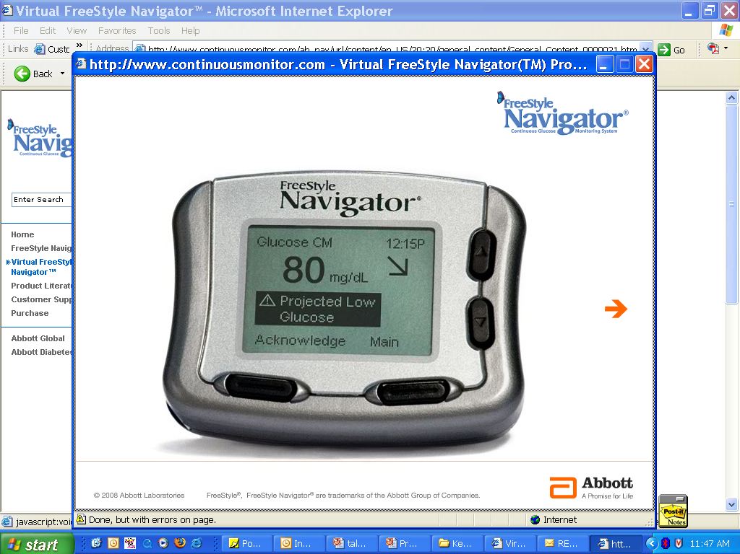
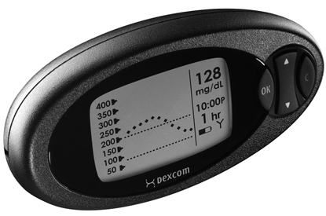
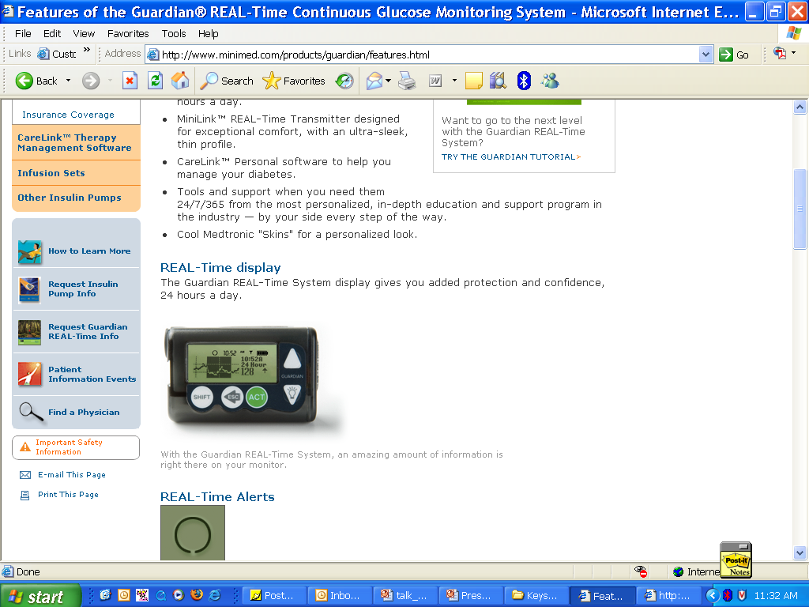
C)Receiver or Monitor

Slide 16
What does “Calibration” mean and why do I need to do it?
Calibration is a process that gives a fingerstick BG value to the CGM system so the values will align with each other
Number of Calibrations vary by device
Best times to calibrate are when the BG values are stable: before meals and before bed
Do not calibrate when arrows are present

Slide 17
What type of data will we get?
“Real-time” (Immediate)
i. Trend graphs
ii. Alarms
iii. Trend arrows

Slide 18
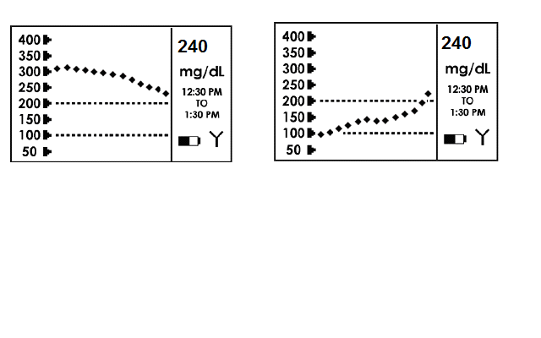
i) TREND GRAPHS
Trend graphs – Knowing a glucose level is 240 mg/dl may not be as important as knowing the “trend.”

Slide 19
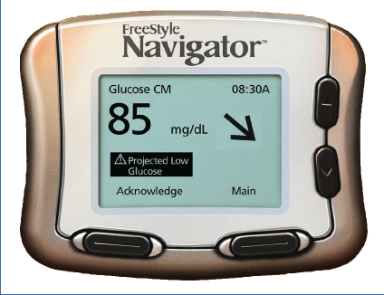
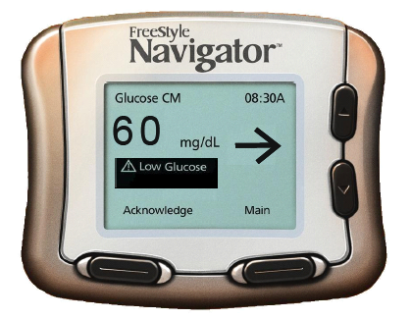
ii) ALARMS Can warn patients of current or projected high and low blood sugar
Projected alarms: 10, 20, or 30 minute warning of impending hypo- or hyperglycemia (Navigator and Guardian devices)
Threshold alarms: warning when glucose is below or above a set value (all devices)

Slide 20
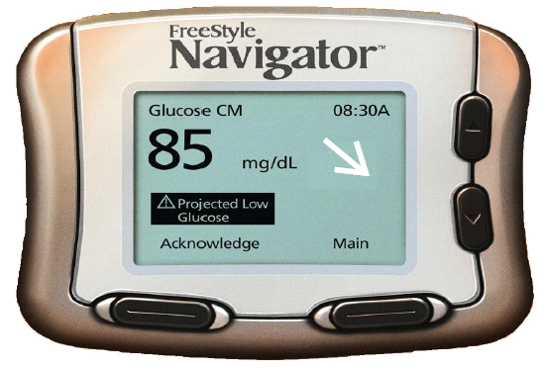
iii) TREND ARROWS Rate of Change Arrows
Gives the up-to-the-minute glucose value and a rate of change arrow
Glucose rising quickly
>2 (mg/dL)/min
Glucose going up
1 to 2 (mg/dL)/min
Fairly stable glucose
-1 to 1 (mg/dL)/min
Glucose going down
-1 to -2 (mg/dL)/min
Glucose falling quickly
>-2 (mg/dL)/min
Barbara Davis Center for Childhood Diabetes May 2008

Slide 21
Second type of data: [for analysis] (Retrospective, must download)
2) Retrospective
Modal Day Graphs
Pie Chart
Statistics

Slide 22
CLOSED LOOP (BIONIC) PANCREAS
“The Future”
Will probably come in parts
JDRF supporting algorithm development
Should reduce glucose highs, lows, and fluctuations
Will probably be more realistic than islet cell transplant
FDA and medical insurance approvals (as with CGM) will be critical

Slide 23
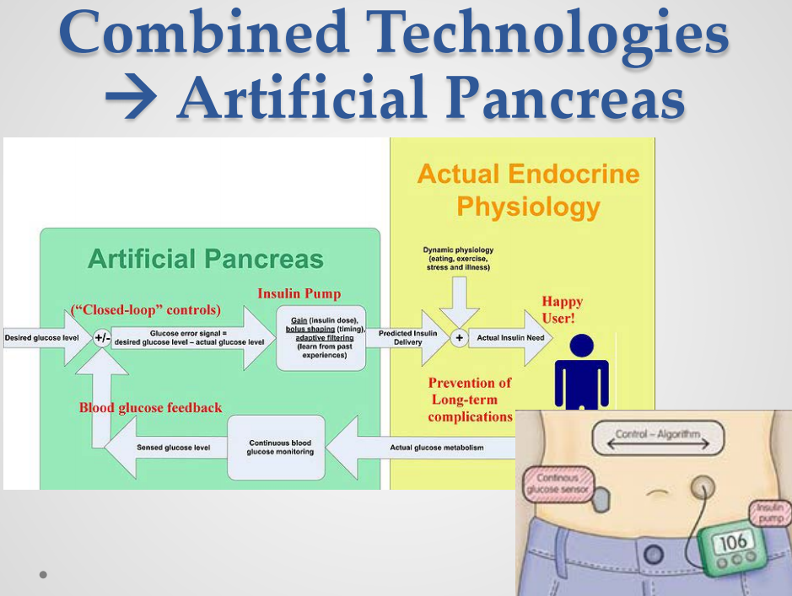

Slide 24
Q. Why combine insulin pumps (CSII) and Continuous Glucose Monitors (CGM)?
A: “They complement each other tremendously and provide the most ‘state of the art’ diabetes care available.”
The CGM helps with:
Cannulas dislodging
Missed food boluses
Hypoglycemia
Corrections

Slide 25
Some Widely used CGMS Systems

Slide 26
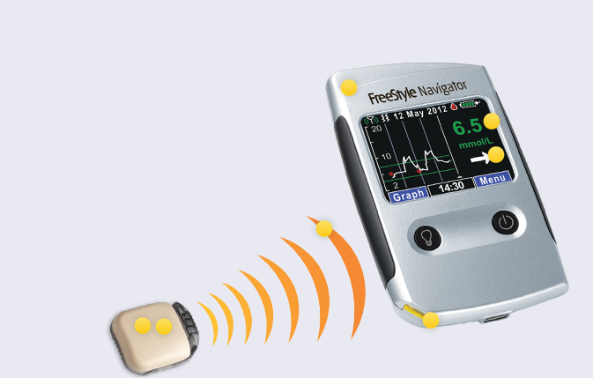
Notes:
Free style navigator by Abott

Slide 27
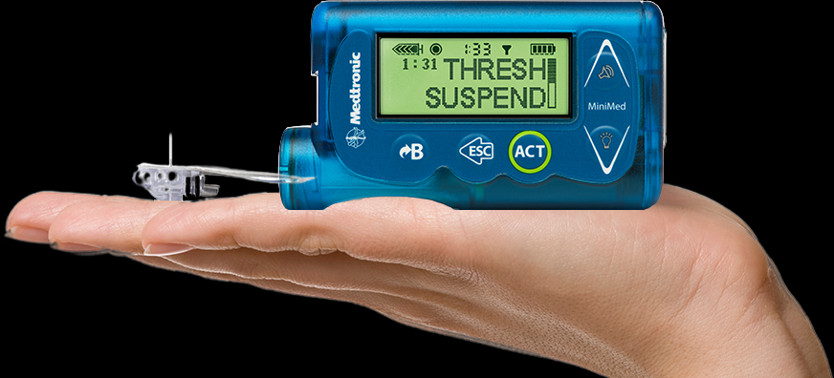

Slide 28
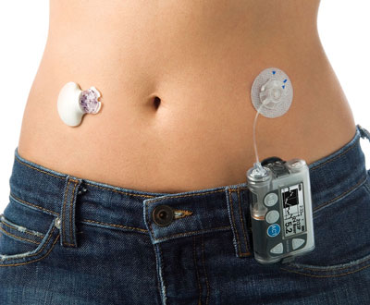
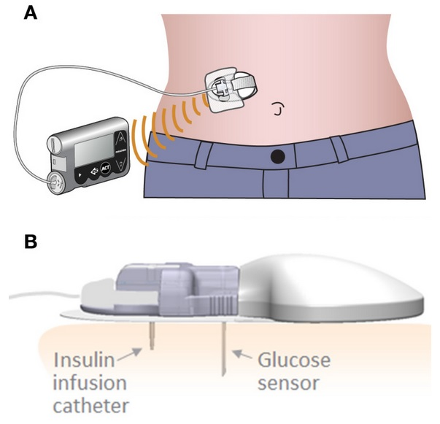

Slide 29
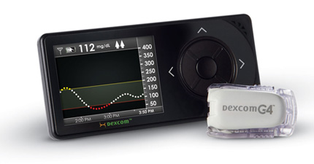

Slide 30
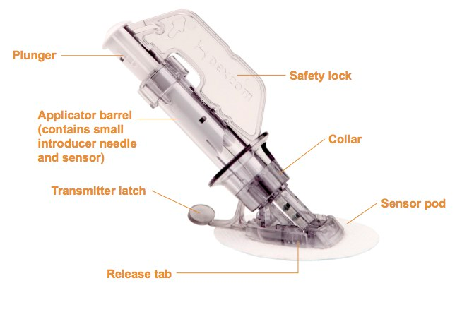
Notes:
Patch Applicator

Slide 31
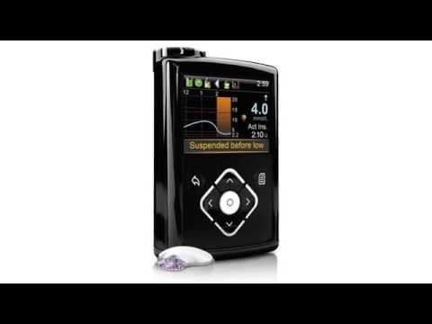

Slide 32
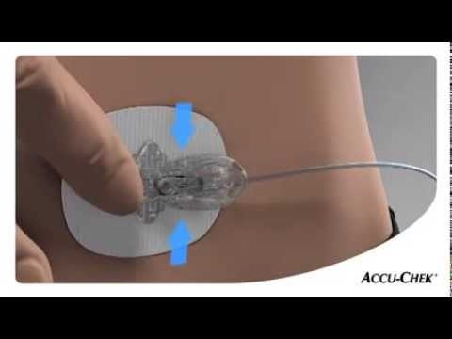

Slide 33
Concepts for Continuous Delivery

Slide 34
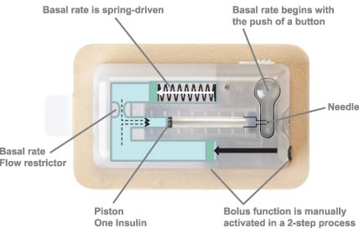
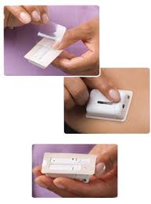

Slide 35
What about kids suffering from diabetes?
The explained procedures are
Messy
Risky(due to needles and invasiveness)
Can be lethal if not managed properly
Notes:
http://diabeteskit.melchiorvanvoorden.nl/

Slide 36
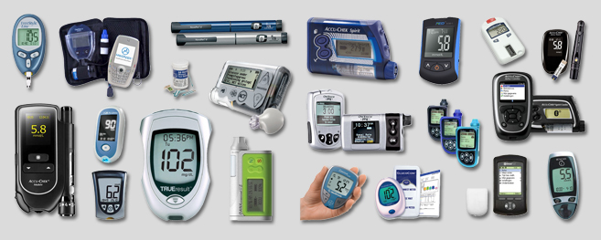

Slide 37
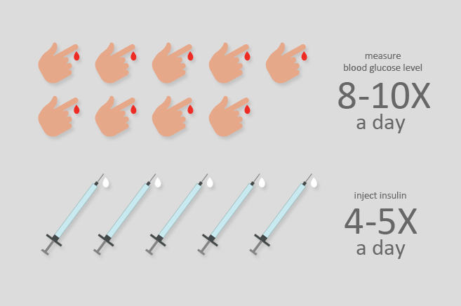

Slide 38
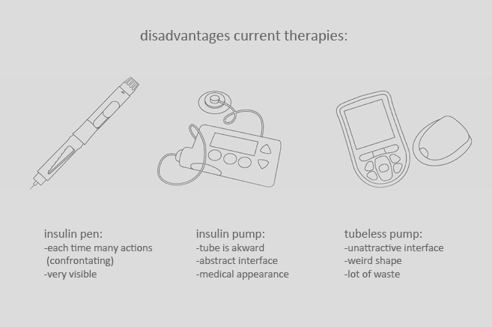

Slide 39
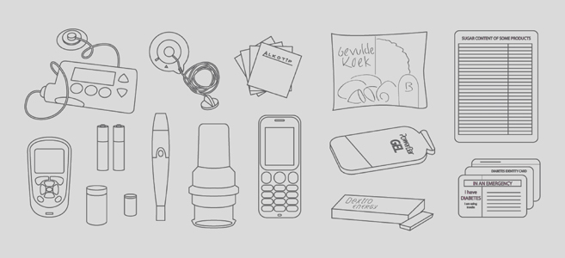

Slide 40
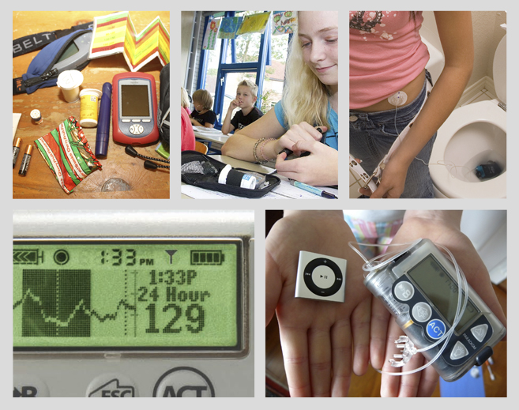

Slide 41
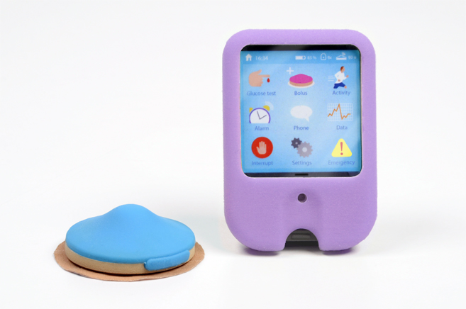

Slide 42
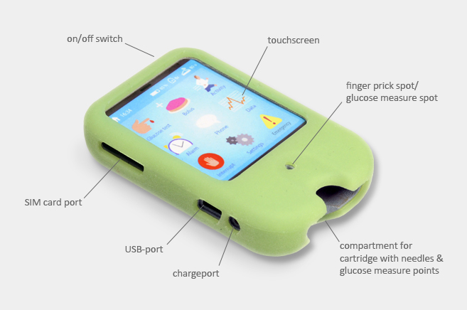

Slide 43
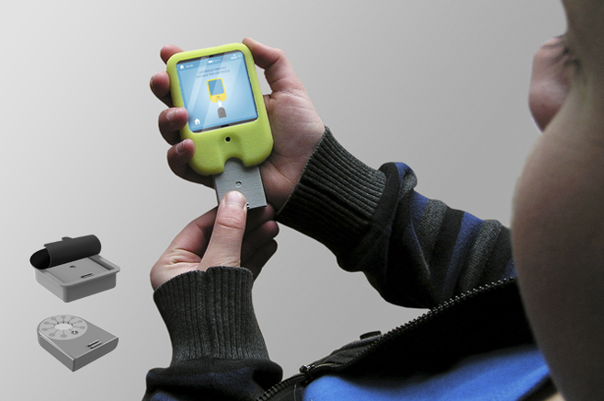

Slide 44
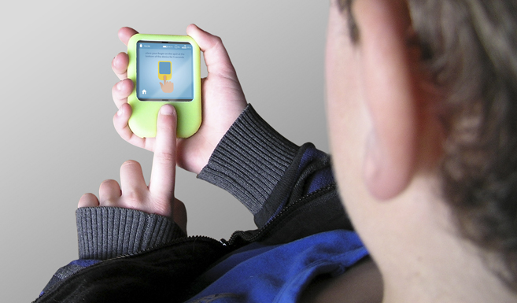

Slide 45
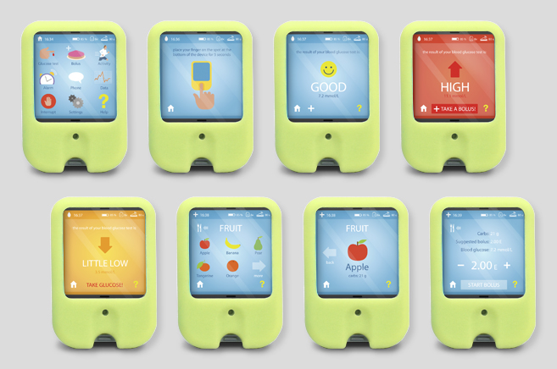

Slide 46
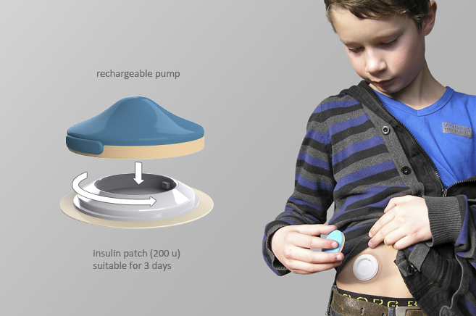

Slide 47
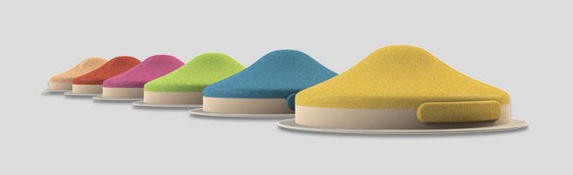

Slide 48
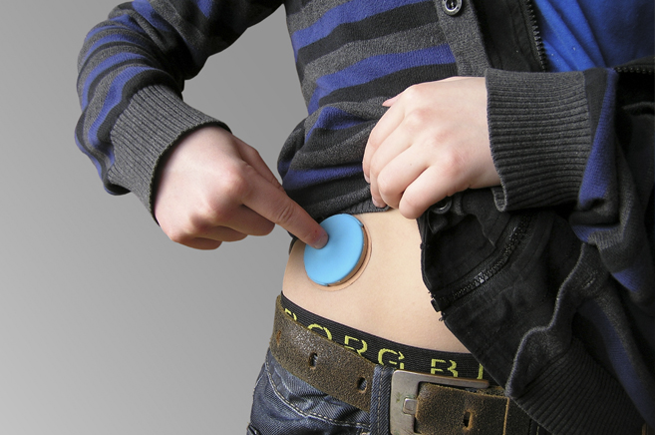

Slide 49
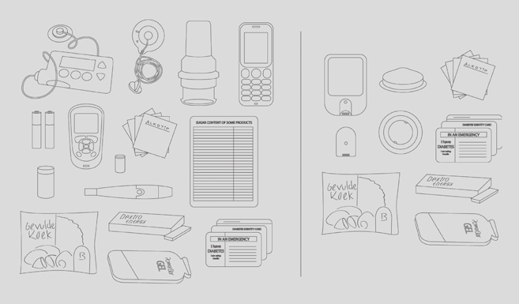

Slide 50
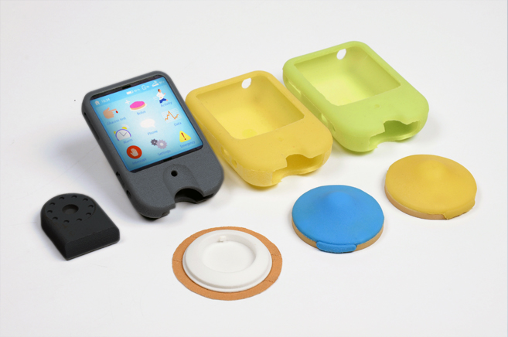

Slide 51
Enthusiastic about exploring new healthcare and medical technologies?
Drop a mail on:
nanobios.iitb@gmail.com
Or visit us at:
NanoBios Lab
Lab# - 505
5th Floor New BSBE,
Behind New LHC
IIT Bombay.
Tel.022-25767746 / 71
Notes:
We do a lot of constructive brainstorming and prototyping at Nanobios Lab in terms of devices, processes and other technological areas relevant to biology.
To get a gist of what we do and what are we working upon you can drop us a mail or visit our lab after informing in advance.

